Slide 1

MCP Integration with Databricks: Enabling AI-Powered Data Operations
A Demo of Custom Tools for Read/Write in AI Workflows
Presented by Praveen Dantam
This presentation explores how Model Context Protocol (MCP) creates a seamless bridge between AI models and Databricks, enabling natural language data operations that transform how technical teams interact with their data infrastructure.

Slide 2
Agenda
01
02
03
Introduction to MCP
MCP Integration with Databricks
Advantages & Use Cases
Understanding the Model Context Protocol and its significance in modern AI/ML workflows
Benefits and practical applications for data engineering teams
Setup, architecture, and implementation details
04
05
Limitations & Challenges
Key Takeaways & Discussion
Current constraints and recommended workarounds
Summary points and open forum for questions
We'll explore each topic with practical examples from our e-commerce demo project.

Slide 3
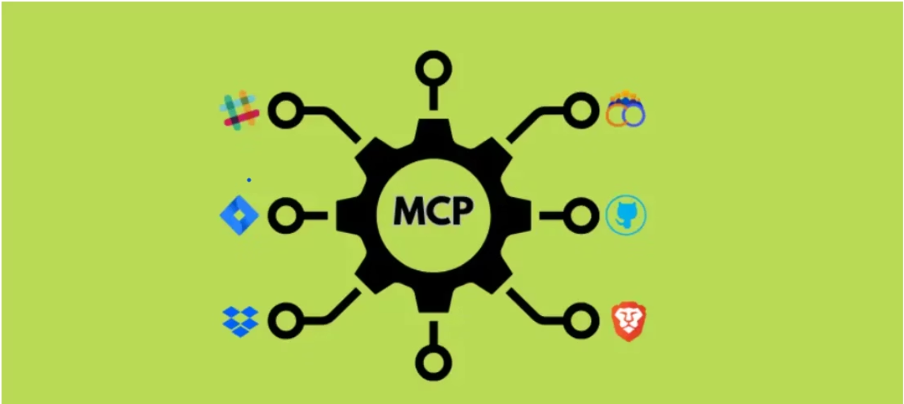
Introduction to MCP
What is MCP and why it matters
Model Context Protocol (MCP): An open standard enabling AI models like Claude to interact with external tools and databases via function calls
Why it matters: MCP bridges the gap between AI and real-world data, allowing models to:
Query databases using natural language
Perform data operations without custom coding
Access and manipulate information in controlled environments

Slide 4

How MCP Fits Into Modern AI/ML Workflows
User Request
MCP Client
"List all tables in the e-commerce database"
Identifies need for external tool
MCP Server
Databricks
Executes function call via server.py
Processes SQL and returns results
Key Benefits:
Accelerated Development
Simplified Architecture
Secured Data Access
Reduces prototype-to-production timeframes by 60%
Eliminates complex integration layers
Granular control over read/write operations

Slide 5
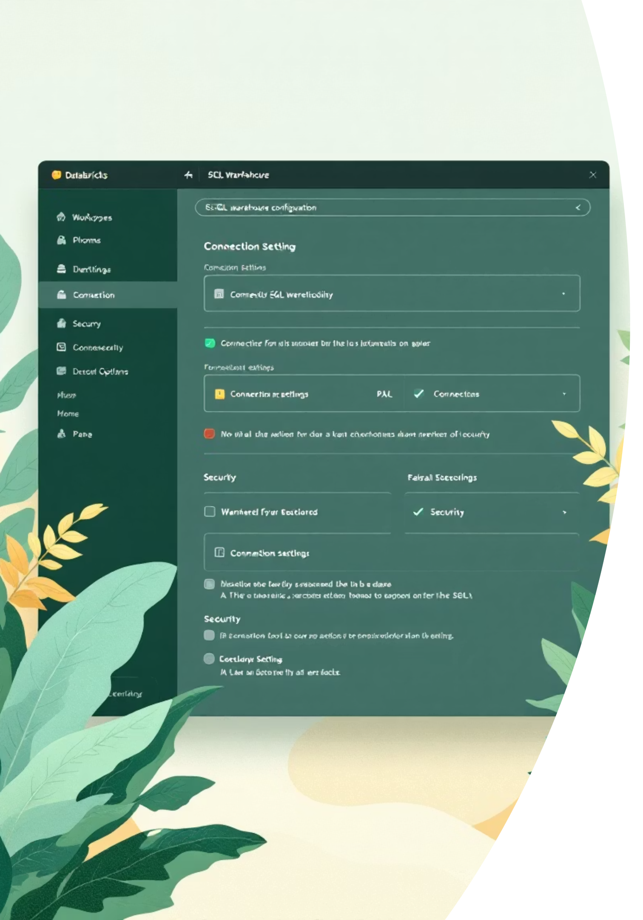




MCP Integration with Databricks
Setup and Configuration Overview
Databricks Setup
Create workspace, SQL warehouse, and set up Unity Catalog
Authentication
Generate Databricks token and store in .env file
MCP Server
Deploy Python script (server.py) with FastMCP + databricks-sql connector
MCP Client
Add JSON configuration for MCP server in MCP client
Security is prioritized through read-only default configurations with optional controlled write access that requires explicit authorization.

Slide 6
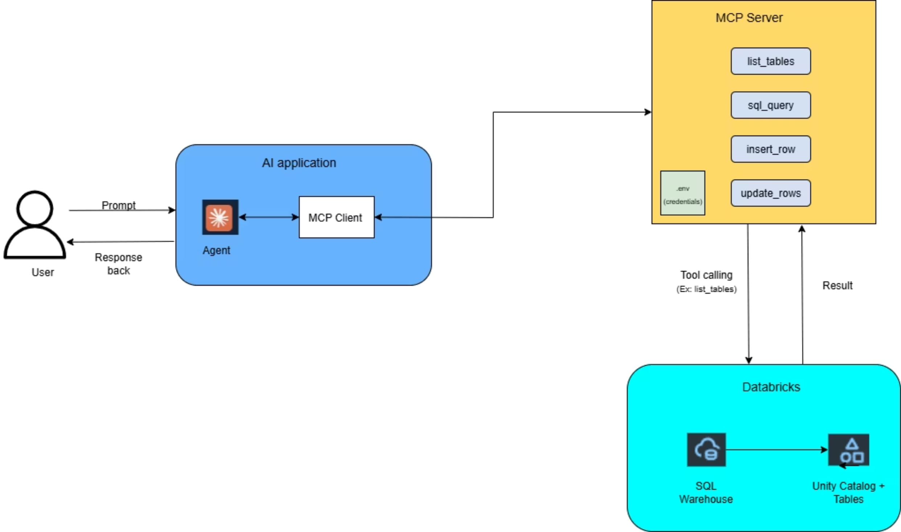
MCP-Databricks Integration Architecture

Slide 7

Demo Project: MCP with Databricks SQL
Technical Deep Dive
This segment will demonstrate a practical implementation of MCP within the Databricks environment, showcasing how secure computation is achieved step-by-step.

Slide 8



Advantages & Key Benefits
Natural Language Data Access
Automated Data Operations
Controlled Access
Simplify routine data tasks through conversation
Fine-grained permissions with read/write controls
Ask questions in plain English instead of writing SQL queries
"Update inventory for products below reorder threshold"
Restrict operations to specific tables or schemas
"Show me the top 5 products by revenue this month"
Team Benefits
Data Engineers
Analysts
Product Teams
Reduced boilerplate code and faster implementation of data pipelines
Query complex data without deep SQL knowledge
Rapid prototyping of data-driven features

Slide 9

Limitations, Challenges & Best Practices
Current Limitations
Effective Workarounds
AI guardrails may restrict write operations
For Write Operations
Complex queries require careful prompting
Dependency on security tokens that expire
Use explicit prompts that directly specify the tool: "Please use the insert_row tool to add this product"
Best Practices
Use absolute paths in configurations
For Complex Queries
Test functions in MCP Inspector first
Ask Agent to generate the SQL first, review it, then ask to execute it
Restart application after tool changes
For Security
Rotate tokens regularly and implement scoped access with Unity Catalog

Slide 10


Slide 11: Key Takeaways
Key Points
1
Capabilities
Seamless AI-DB integration for reads/writes.
2
Future Potential
Advanced tools (e.g., ML integrations), broader adoption.
3
Challenges Ahead
Overcoming AI safety limits, scaling security.

Slide 11


Slide 12: Q&A / Open Discussion
Have questions or want to explore how our solutions can benefit your workflows? Let's have an open discussion. Contact us for more information!
Contact Info: Email: praveen.dantam@ignitedata.ai | Phone: 973-752-5184

